Slide 1
ENDOPHTHALMITIS Sam Ath HUON first year resident

Slide 2
OUTLINE
Definition
Classification
Pathogenesis
Ocular manifestation
Diagnosis
Treatment
Endophthalmitis Vitrectomy Study
Prophylaxis

Slide 3
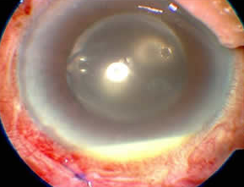
DEFINITION
Inflammation within the ant. or post. segment, or both, concurrent with partial-thickness involvement of an adjacent ocular wall.
concomitant infective scleritis or keratitis. (vitreous is in direct contact with the retina)
Vision-threatening => should be managed emergency!!

Slide 4
Endophthalmitis
Exogenous
Endogenous
Postoperative
Post-traumatic
focal
Diffuse
Panophthalmitis
Acute
Delayed
onset
Conjunctival
filtering bleb
Posterior
Posterior
Anterior
Anterior

Slide 5
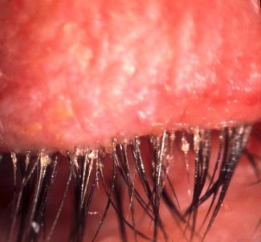
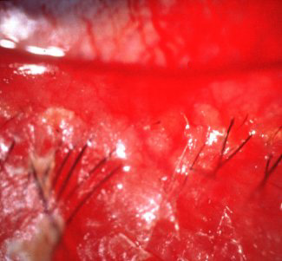
Exogenous endophthalmitis
Preoperative risk factors
Eyelid abnormalities
Blepharitis
Conjunctivitis
Canaliculitis
Lacrimal duct obstruction
Contact lens wear
Ocular prosthesis
Ocular surface and adnexa

Slide 6
Intraoperative risk factors
Inadequate eyelid and conjunctival disinfection
Prolonged surgery (longer than 60 minutes)
Vitreous loss
Use of prolene haptic IOLS
Unplanned ocular penetration during ocular surface surgery

Slide 7
Endogenous endophthalmitis
Risk factors
Immunocompromised host
indwelling catheters
abnormal surgery
long time antibiotic use

Slide 8
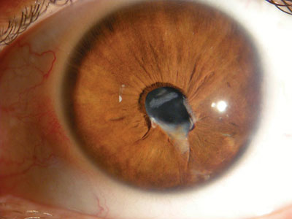
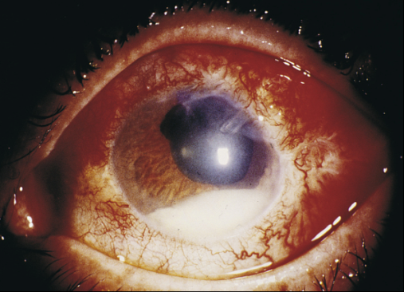
Post-traumatic endophthalmitis
Risk factors
Dirty
retained IOFB
lens capsule breach
delayed wound repair

Slide 9
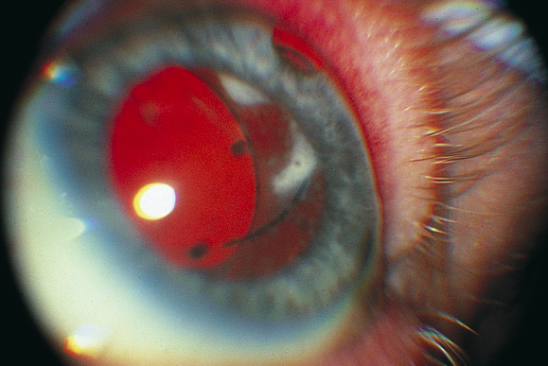
OCULAR MANIFESTATION
Symptoms : Pain, BOV, fIoaters, photophobia and headache and fever.
Signs :
A/S
Decreased visual acuity
Eyelid edema, Erythema
Conjunctival hyperemia, Chemosis
Corneal edema & Opacification
AC flare and cells ,Keratic precipitates (low grade in delayed)
Hypopion (not in delayed)

Slide 10
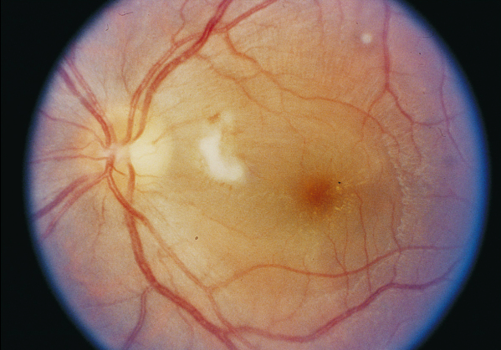
OCULAR MANIFESTATION
P/S
Vitritis
Scattered retinal haemorrhages
Periphlebitis if retina visible
Loss of red refex
Capsular plaque (in delayed)

Slide 11
DIAGNOSIS
A complete ocular and medical history
Ultrasonography : retinal and choroidal detachement
Culture aspiration from aqueous and vitreous cavity
Using a 25-gauge or smaller needle, 0.1 mL of aqueous is aspirated from AC
23-gauge needle inserted into the anterior vitreous cavity : 0.2 mL of liquid vitreous is aspirated
3 mm posterior to pseudophakic limbus,
4 mm posterior to phakic limbus.

Slide 12
TREATMENT
Medical
Rapid administration of AB
broad-spectrum coverage for both gram-positive and gram-negative

Slide 13
Subconjunctival and topical antibiotics
subconjunctival vancomycin (25 mg) and ceftazidime (100 mg)
topical vancomycin (50 mg/mL) and ceftazidime (100 mg/1mL) alternating every half-hour
Systemic
intravenous systemic antibiotics (ceftazidime and amikacin) are not useful adjuncts to intravitreal antibiotics

Slide 14
3. Corticosteroid therapy
To reduce the destructive effect of the significant inflammation that coexists with infection
Prednisone, 1 mg/kg orally each morning for 3 to 5 days
Intravitreal dexamethasone (400 microgram/0.1 mL)
Topical prednisone acetate 1% every 1-2 hours
Subconjunctival dexamethasone 4 to 8 mg

Slide 15
4. Vitrectomy
potential advantages of removing the infecting organisms and associated toxin
removing vitreous membranes that could lead to retinal detachment
improving intraocular distribution of antibiotics

Slide 16
Drug Used in the Endophthalmitis Vitrectomy Study for
Treatment of Acute Postoperative Endophthalmitis
Route of administration | Drug | Dose
Intravitreal | Amikacin Vancomycin | 0.4 mg in 0.1 mL 1.0 mg in 0.1 mL
Subconjunctival | Vancomycin Ceftazidime Dexamethasone | 25.0 mg in 0.5 mL 100.0 mg in 0.5 mL 0.6 mg
Topical | Vancomycin Amikacin | 50.0 mg/mL drops every hour 20.0 mg/mL drops every hour
Systemic | Ceftazidime Amikacin Prednisone | 2.0 g intravenously every 8 h 7.5 mg/kg initially followed by 6.0 mg/kg every 12 h 30.0 mg twice a day (5-10 days)

Slide 17
Endophthalmitis Vitrectomy Study
Patients were randomized to receive either vitrectomy or vitreous tap for biopsy
Further randomized either to receive or not to receive intravenous antibiotics
All patients received standard
Intravitreal Amikacin 0.4mg/0.1ml + Vancomycin 1mg/0.1ml
Sub-conj Vancomycin 25mg + 100mg ceftazidime + 6mg dexamethasone

Slide 18
Endophthalmitis Vitrectomy Study
Results Vitreous culture:
70% Gram+ coagulase negative staph especially staph epidermi
15% other Gram+
6% Gram-
9% multiple organisms
Visual acuity
Final post-treatment VA is 20/40 or better in 53%

Slide 19
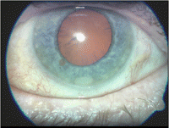
Treatment outcomes
Patients with presenting VA of PL benefits from vitrectomy
Patients with presenting VA better than PL did not benefit from vitrectomy.
No benefit was found with the use of intravenous antibiotics

Slide 20
Prophylactic measures :
Preoperative :
Careful assessment of external ocular surface, Conjunctival culture if external inflammation & discharge
Treatment of eyelid infections (lid hygiene,topical /systemic antibiotics)
Syringing of lacrimal system if infection/obstruction
Topical antibiotics 24 hrs prior to surgery
Systemic antibiotic prophylaxis in high risk cases

Slide 21
Intraoperative
Sterile draping to exclude eyelids & lashes from operative field
5 % povidone iodine to prepare ocular surface,lid margin
10 % povidone to clean surrounding skin
Irrigation of IOLS before insertion
Minimum exposure time of IOL
Careful wound closure

Slide 22
Post operative :
Topical Antibiotic and steroid
Closer postoperative follow-up for patients in diabetes, prolonged surgery, vitreous loss.

Slide 23
Thank you

